Slide 1


The profile of human trafficking offenders in Northern Ireland and an exploration into coercive control.
Emma Richmond
Probation Officer

Slide 2
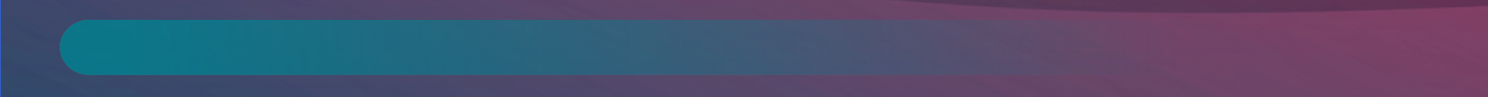
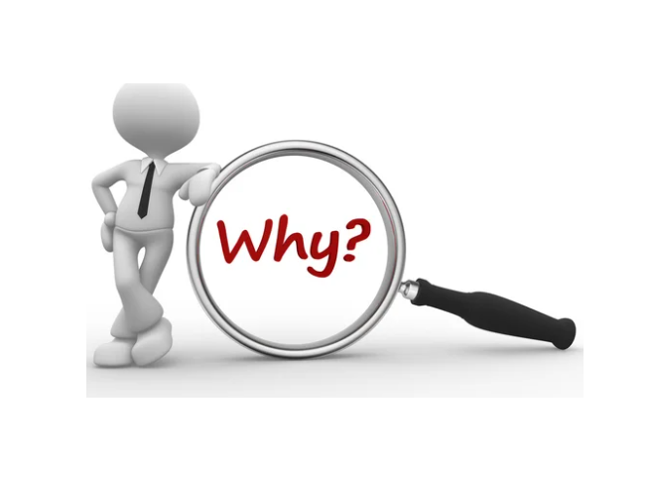
Changing Lives for Safer Communities
True scale of this offending is unknown.
To make informed and defensible decisions requires understanding this type of offending.
Research relating to perpetrators of this type of offending is in its infancy.

Slide 3

Changing Lives for Safer Communities
During COVID-19 pandemic.
Retrospective content analysis of identified case files.
Audit tool created.

Slide 4
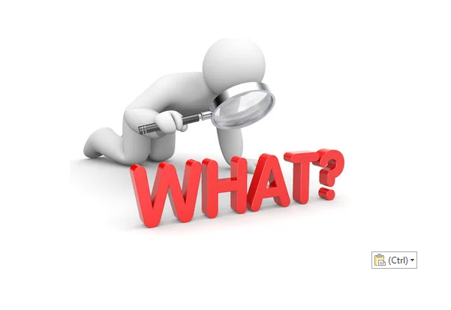
Changing Lives for Safer Communities
3 key themes:
Perpetrators self-report
Victim specific information
Coercion and/ or control
Sentenced in Northern Ireland.
Case files that a Pre-Sentence Report completed.
13 identified case files.

Slide 5

Changing Lives for Safer Communities
All identified victims were the same original nationality as the perpetrator (s).
In the majority of files, the identified criminogenic need was financial gain.
Debt bonds linked to 11 of 13 files.
9 coercion / control tactics identified.
Monopolisation of victim specific knowledge/ previous experienced traumas.
Link to Domestic Abuse theory and implications of ‘trauma-coerced attachment’.

Slide 6

Changing Lives for Safer Communities
Evidence informed assessments for courts and case-planning.
Support creation of bespoke interventions.
Increases evidence base to aid contextualising practice within local contexts.
Knowledge is applicable to develop practice in agencies working with victims.

Slide 7
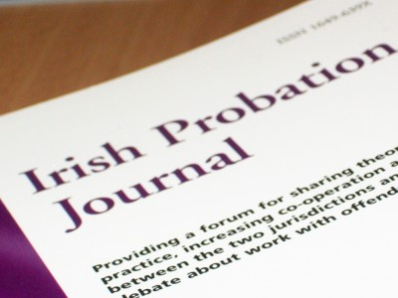
Changing Lives for Safer Communities
“I couldn’t get out the door …. there was no freedom for me to go and walk around and I wanted to do that and I wanted to get out for some fresh air and walk around, they wouldn’t let me get out”
Richmond, E., Cunningham, T. and Killick, C. (2022), ‘An Exploration of the Profile and Characteristics of Human Trafficking Northern Ireland’, Irish Probation Journal, vol. 19, pp 119-136 https://www.pbni.org.uk/publication/ipj-vol-19-exploration-profile-and-characteristics-human-trafficking-northern-Ireland

Slide 8



Changing Lives for Safer Communities
Questions?
info@probation-ni.gov.uk
www.pbni.org.uk
Follow us on socials:
Changing Lives App

