Slide 1
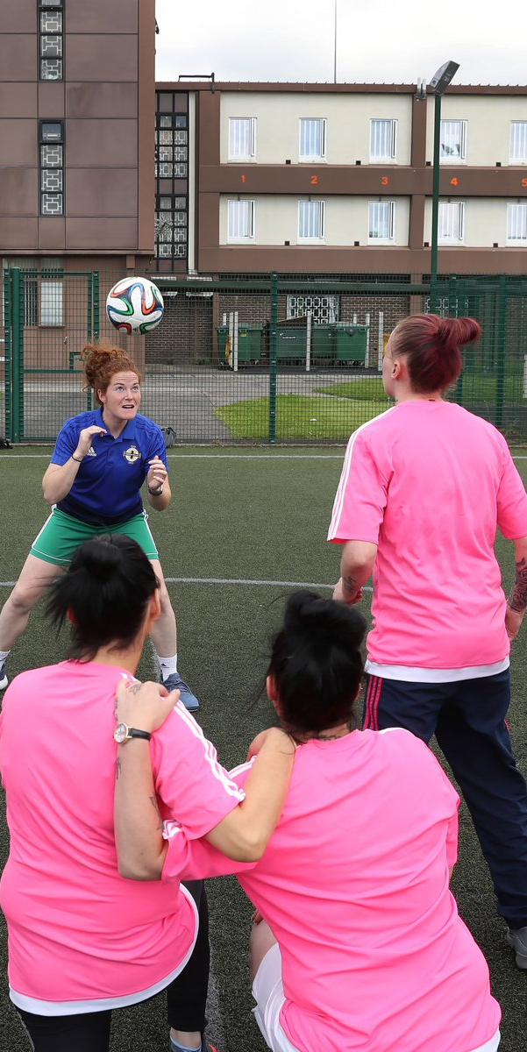

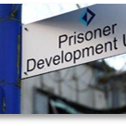
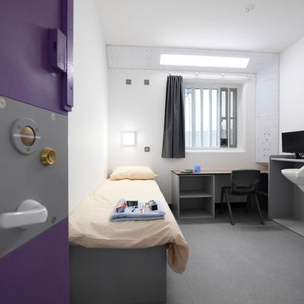
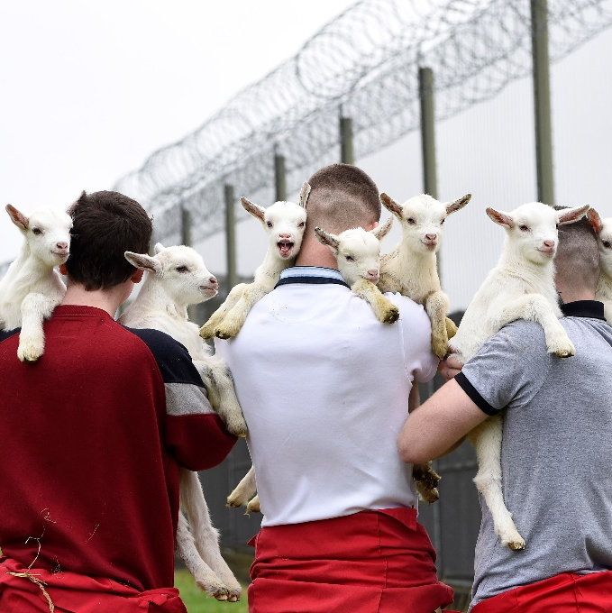
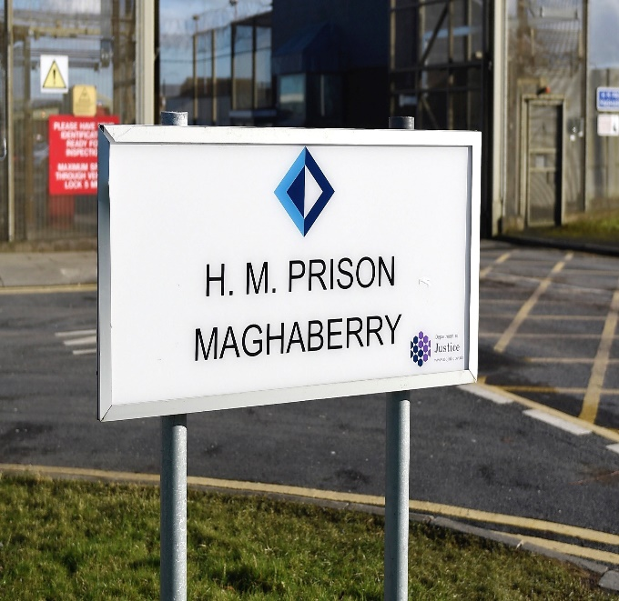

Making the community safer by challenging and supporting people to change
Governor Mark Holmes

Slide 2

Our Aims
Keep people in our care safe and secure.
Challenge and support people to change.
To help build a safer community by reducing people’s risk of re-offending

Slide 3
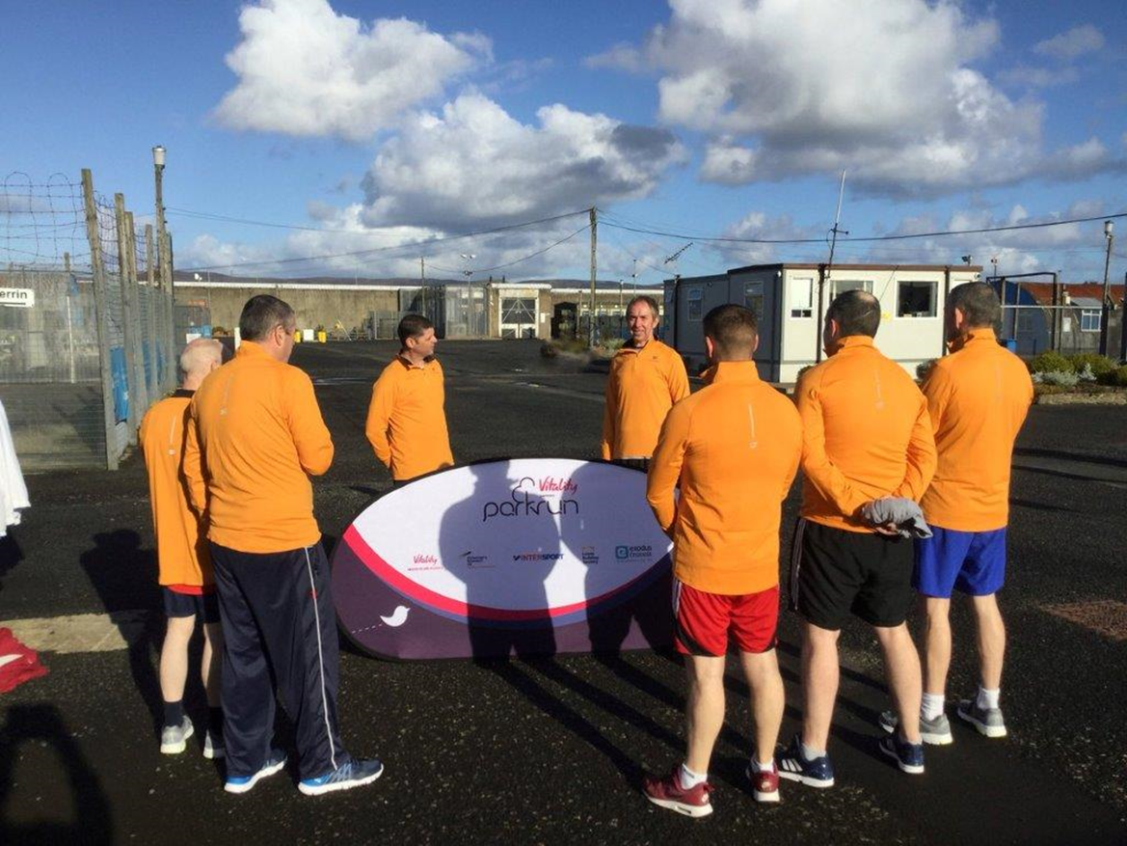
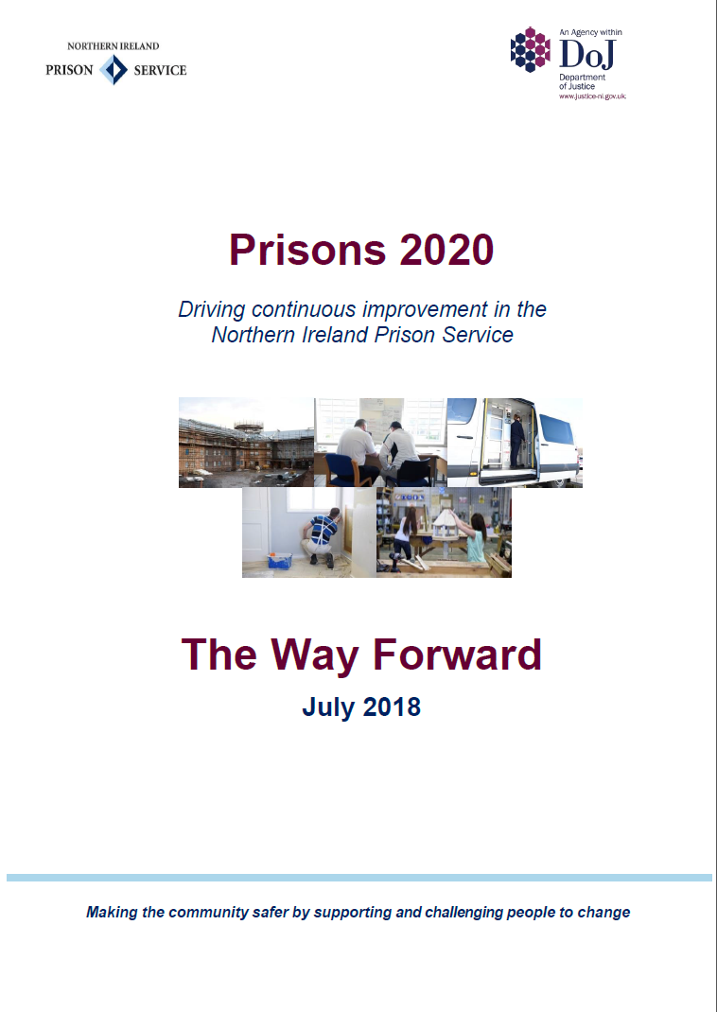
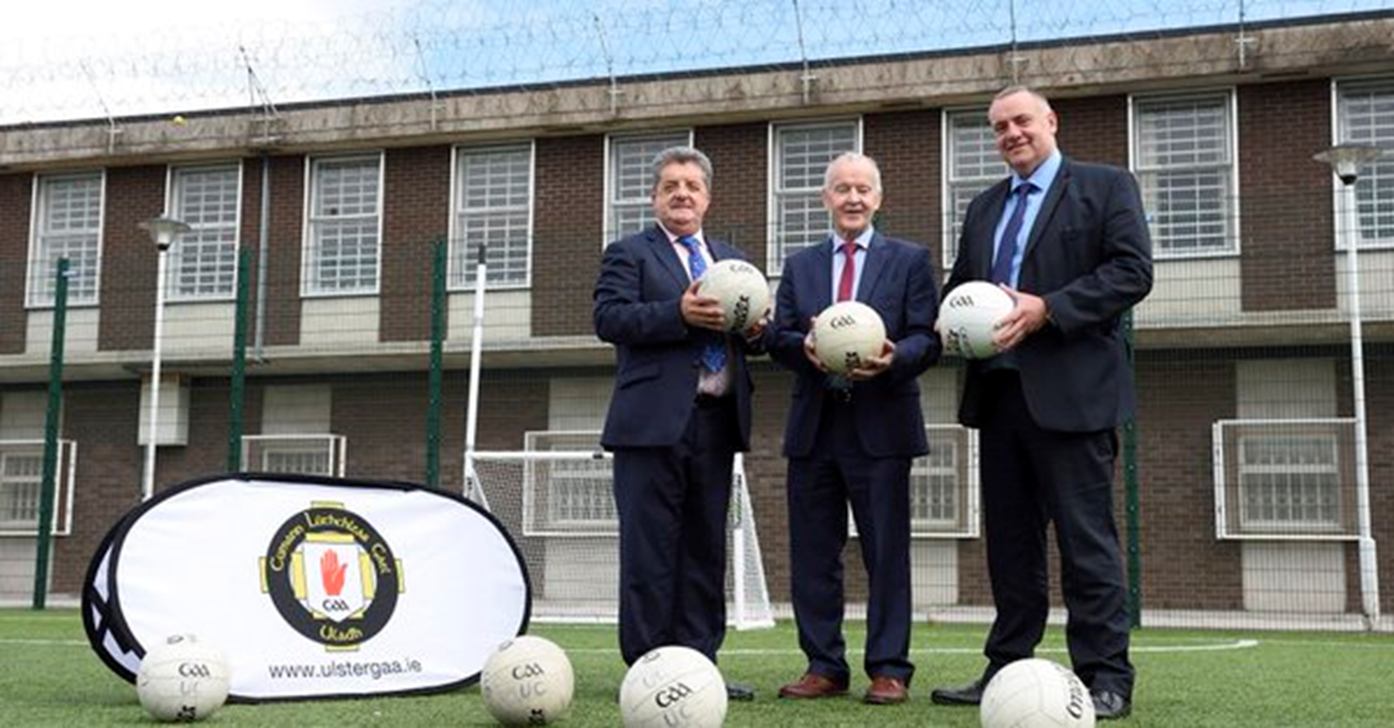

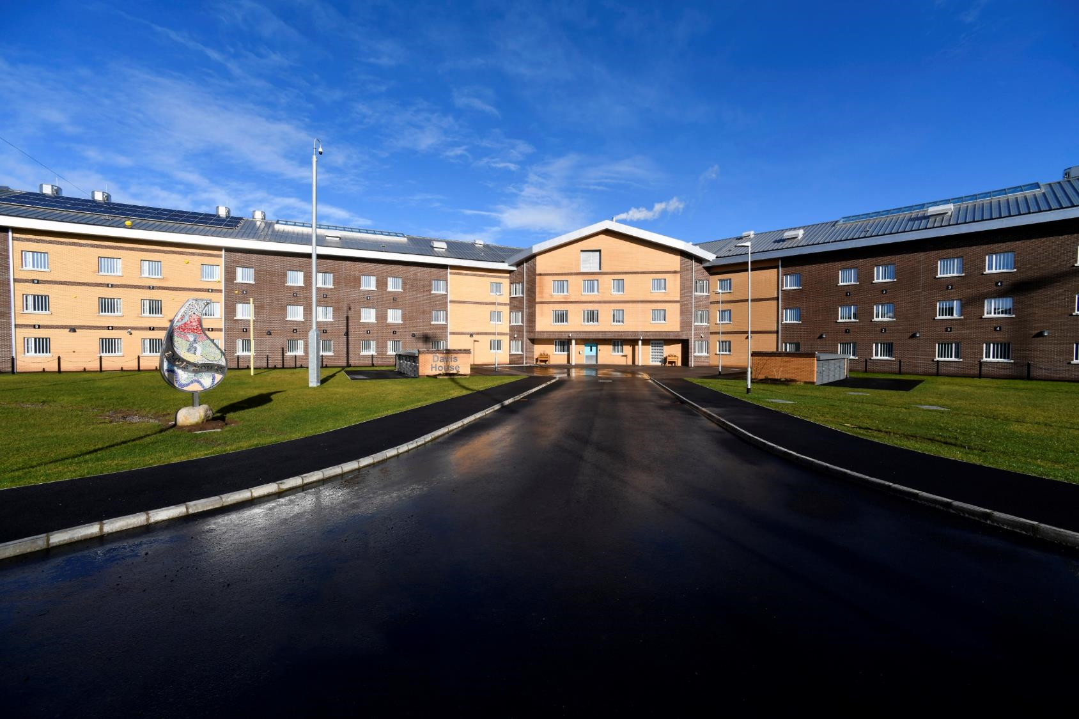
Prisons 2020 – Some Key Achievements
OUR PEOPLE
OUR PARTNERSHIPS
Future Leaders Scheme – developing operational staff to be future Governors
Prisons Well – a programme for staff wellbeing
Recognition – improving the local, national and international perception of prisons in Northern Ireland
A new Service Level Agreement to support learning and skills delivery by local FE colleges
Joint working and initiatives with SE Trust to improve healthcare in prisons
Progressive partnerships with the Irish Prison Service, HMPPS, PBNI and the PSNI
Strong relationships with the VCS supporting delivery.
OUR SERVICES
OUR INFRASTRUCTURE
Implementation of SPAR Evolution – to better support vulnerable individuals
Implementation of a Strengthening Family Relations Strategy
Dedicated residential landing to support mental health, family engagement, older people
Opening of Davis House - modern, 360 cell accommodation block
Estates 2020 – a route map for improving our estate
Introduction of a Prisoner Portal, in-cell telephony, tablets etc.
Replacement of PECCS fleet

Slide 4
Key Challenges
Increased prison population
High remand population
Public Sector Budgets
Increased complex needs

Slide 5
Population in Prison Establishments
Maghaberry Prison
Maghaberry is a high security prison housing adult male long-term sentenced and remand prisoners, in both integrated and separated conditions.
36% population increase
Magilligan Prison
Magilligan is a medium secure training prison holding sentenced prisoners usually received from Maghaberry.
25% population increase
Hydebank Wood College
Hydebank Wood College accommodates young male offenders aged 18-24 and all of Northern Ireland’s female prisoners.
A relatively stable male population and 100% female population increase

Slide 6
Total Prison Population in NI
Total Population Increase
Between 1 March 2021 and 1 November 2023, the total NI prison population has increased from 1,401 to 1,878 (by 477 or 34%).
Between 1 March 2022 and 1 November 2023 alone there has been an increase of 302 prisoners.
Prisoners on Remand
The percentage of the average daily prison population who are on remand continues to increase from approximately 25% in 2015/16 to 36% in 2022/23.
Remand receptions increased by 16.5% over the last year, up from 2,722 in 2021/22 to 3,171 during 2022/23.
Causes
This sustained increase in the prison population in NI is likely to have similar drivers to those in other jurisdictions, including the recovery of the justice system post-Covid-19.

Slide 7
Population Trend and Projection
Projections based on the population changes since the beginning of 2021 suggest that in early 2024 the overall prison population will exceed 2,000.
This is likely to mean that the population at Maghaberry will be in excess of 1,300 prisoners.
The remand population will continue to increase and make up a significant proportion of people in custody.

Slide 8



Remand Comparison 2021/22
28.0%
27.8%
32.2%
36.5%
35.6%
57.6%
19.5%
16.3%
18.9%
33.7%
16.1%
19.6%
Males
Females

Slide 9
Reoffending Summary 2020/21
Significant decrease (53.8%) in total cohort since 2010/11, but slower rate of change over last 5 years
Similar pattern among numbers reoffending, but decreasing at smaller rate than total cohort
Has led to higher proportion of individuals reoffending (e.g. 2017/18, 2018/19, 2020/21 cohorts)
Similar trends among adults and youths
Smaller numbers since 2015/16 mean reoffending rate more susceptible to change
Specific cohorts of prolific offenders may disproportionately affect reoffending rates
Total cohort | 33,815 | 31,343 | 29,427 | 27,069 | 23,627 | 21,982 | 21,493 | 20,407 | 20,856 | 20,409 | 15,631
Reoffended | 5,646 | 5,869 | 5,452 | 4,890 | 4,221 | 4,059 | 3,862 | 3,884 | 3,860 | 3,358 | 2,935

Slide 10
Reoffending Summary 2020/21
To summarise:
Significant decrease in total cohort and number of individuals reoffending since 2010/11
  Slower rate of change in more recent years
  Lower numbers make rates more susceptible to change
  Issue of prolific offenders
Fluctuations in figures are to be expected as Covid-recovery continues
Highest reoffending rates among:
  Young males (aged 17-29)
  Those released from short sentences (of less than 12 months)
  Those who spend time on remand prior to release from custody (particularly Hydebank Wood and Maghaberry)
Three month window post-release from custody remains crucial
Comparisons with other jurisdictions currently not feasible

Slide 11
Public Sector budgets
Projected £1bn overspend in Northern Ireland Budget for 2023/24
Loss of European Social Fund (ESF)
Limits of the UK Shared prosperity fund
Energy Costs
Lack of Stormont Executive

Slide 12
Complex Needs
Hydebank Wood Women’s Prison
Committal Self Disclosure
Article 51 Committals
 | 2023
Substance Withdrawal | 29%
Substances prior to custody | 54%
Drug User | 63%
Feels at risk in prison | 9%
History of self harm | 58%
Immediate support required | 2%
Increased thoughts of self harm | 15%
Mental Health services support | 43%
 | 2019 | 2020 | 2021 | 2022 | 2023
Article 51 Committals | 2 | 3 | 5 | 4 | 9

Slide 13

Rehabilitation and Resettlement
Processes
Needs assessment on committal
Targeted development plans aligned with needs
Release planning to support transition through the gate
Population
Rising population creating pressures on timely provision
High percentage of remand and short sentence prisoners
Significant increase in the female and older cohorts
POPULATION
PROCESS
Prisoner
Development
Model
RPARTNERSHIPS
PRIORITIES
Partnerships
Cross-executive collaboration with DfC, DfE, NIHE;
Statutory partnerships with PBNI, SET, BMet
VCS delivery through 16 grant funded organisations
Priorities
Sustainability in a rising population
Improving transition to community
Measuring investment value through outcomes

Slide 14














Slide 15
Pathways to Resettlement
ACCOMMODATION
Working with partners including NIHE, DfC and Housing Rights, we aim to provide safe, sustainable accommodation on release, including supported provision for those with higher risk factors.
EDUCATION AND EMPLOYABILITY
Through our SLA with Belfast Metropolitan College, we deliver a diverse curriculum which meets the needs of the population and enhances their employability prospects. DfC work coaches, employability tutors and PDU co-ordinators strive to change mind-sets, preparing them for opportunities in the labour market.
FAMILY ENGAGEMENT
Creating and enhancing positive family connections is facilitated through programme delivery, VCS interventions and the provision of visits tailored to the needs of individuals.

Slide 16
HMPPS Relationship – Visit & Lessons Learned
Safety & Respect
Areas of Challenge
Areas of Opportunity
Older accommodation in-use and crowding increases.
Increased tension, assaults, and incidents.
Safer custody / well being issues become more common.
Staff morale decreases and sickness levels rise.
Regime levels / time out of cell deteriorate.
Refocus on recruitment & retention.
Trauma Informed Practice Health Check.
Revised induction processes at Maghaberry.
Substance Misuse Strategy.
Prisons Well & PRRT Pilot.

Slide 17
HMPPS Relationship – Visit & Lessons Learned
Purposeful Activity & Preparation for Release
Areas of Challenge
Areas of Opportunity
Resources are prioritised to safe, decent and secure custody.
Prisoner Development Units are unable to deliver a structured approach to rehabilitation (i.e. PNPs & PDPs).
People are exiting custody without appropriate release planning arrangements in place, increasing their likelihood of reoffending.
Lack of timely access to rehabilitative support services (VCS, Psychology, L&S) can result in failure to meet statutory requirements (i.e. PCNI) and could negatively impact on a person’s right to freedom.
Review of the Prisoner Development Model.
Cross Departmental coordination.
Learning & Skills Curriculum review.
Working Group on Remand.
Women & Girls Strategy Group

Slide 18
Prisons 25 by 25
Continuous improvement never stops……

Slide 19

Questions?

