Slide 1


NZEB & Retrofitting Accredited Training
“Building for the future”
IPS Work Training

Slide 2

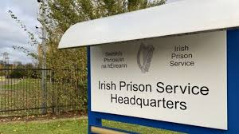

Work Training Overview
HQ level – Care and Rehabilitation Directorate
Policy development
Financial/procurement management
Collation of data
Advice and guidance to prison management
Direction and support to our Chief Officers

Slide 3
Work Training at prison level
Managed by a Chief Officer Grade II (Work Training) - Total of 13 nationwide.
ACO Catering/Bakery - Total of 19 nationwide
Work Training Officers – Total 381
ISM Officer – Total 24

Slide 4

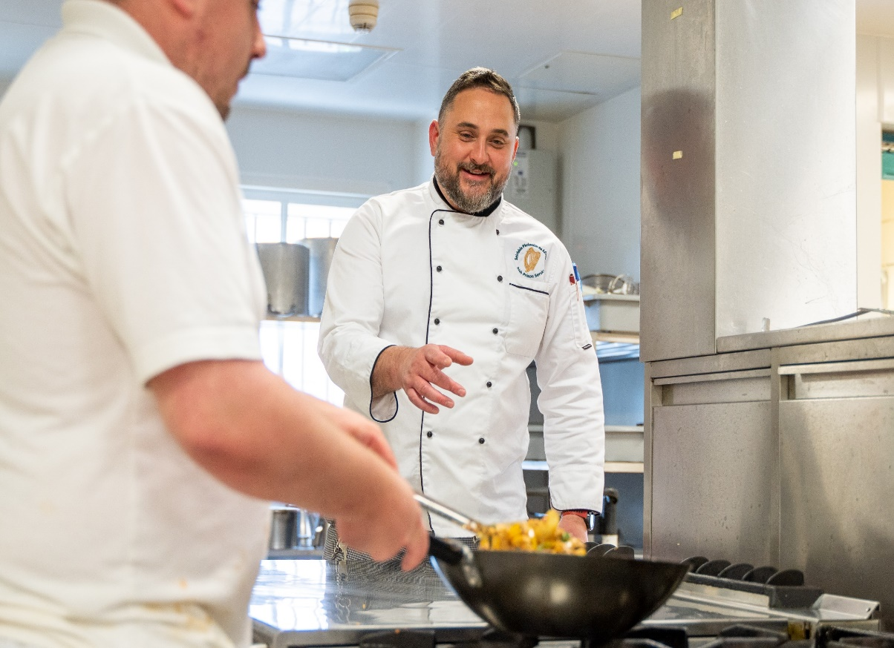
Essential Services include
Catering/Bakery
Industrial Cleaning
Laundry
Waste Management

Slide 5
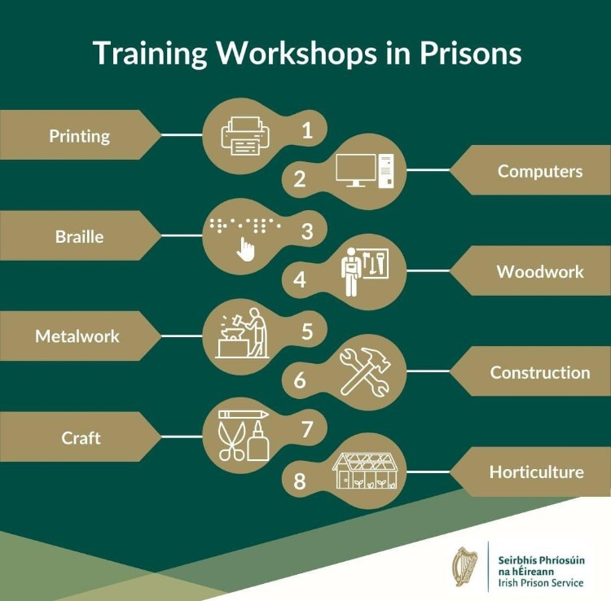
Production Areas
Fabric, Towelling & Embroidery
National Print and Signage
Picture Framing
Bakery Service for all Dublin Prisons
Horticulture and grounds maintenance

Slide 6
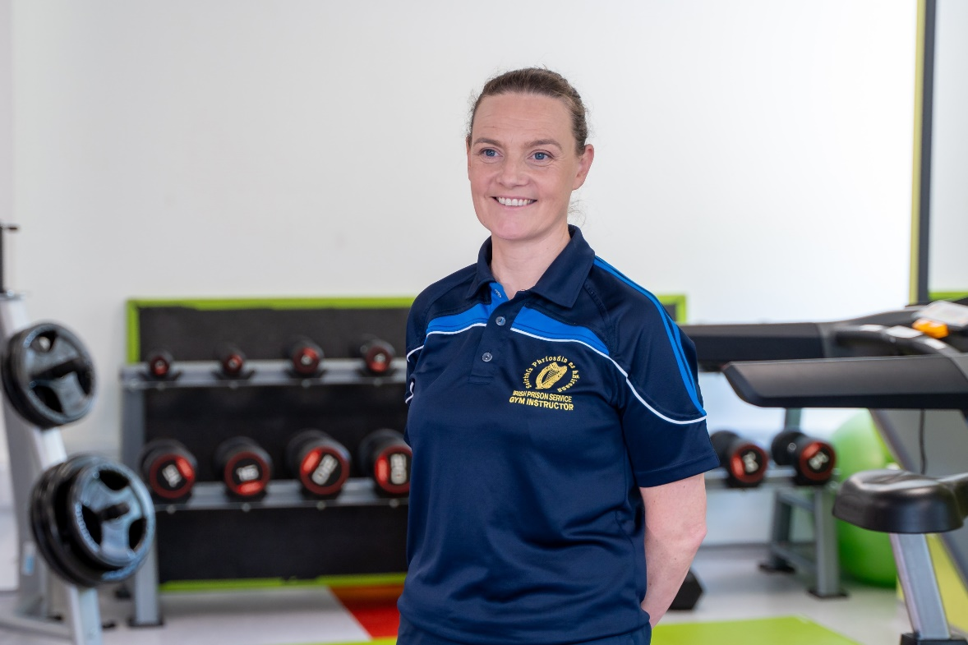
Health & Exercise Activities
All WTO’s assigned to Gym activities are NCEF qualified.
There are a number of activities offered to prisoners including: The Park Run, sporting tournaments, personalised exercise & fitness plans and exercise for the older adult.
Our Open Centres also offer offsite activities such as hill walking and water sports.

Slide 7
Specialised Work Training Activities
Braille Workshop in Arbour Hill
Furniture and Antique restoration Workshop in The Midlands
Registered Men Shed in The Training Unit
Working Farm in both Loughan House and Shelton Abbey
Coffee Shop, Garden Centre and Car Wash facility in Loughan House
Horses for Hope in Castlerea
Hair Dressing and Beauty Therapy in The Dochas Centre

Slide 8
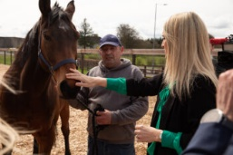
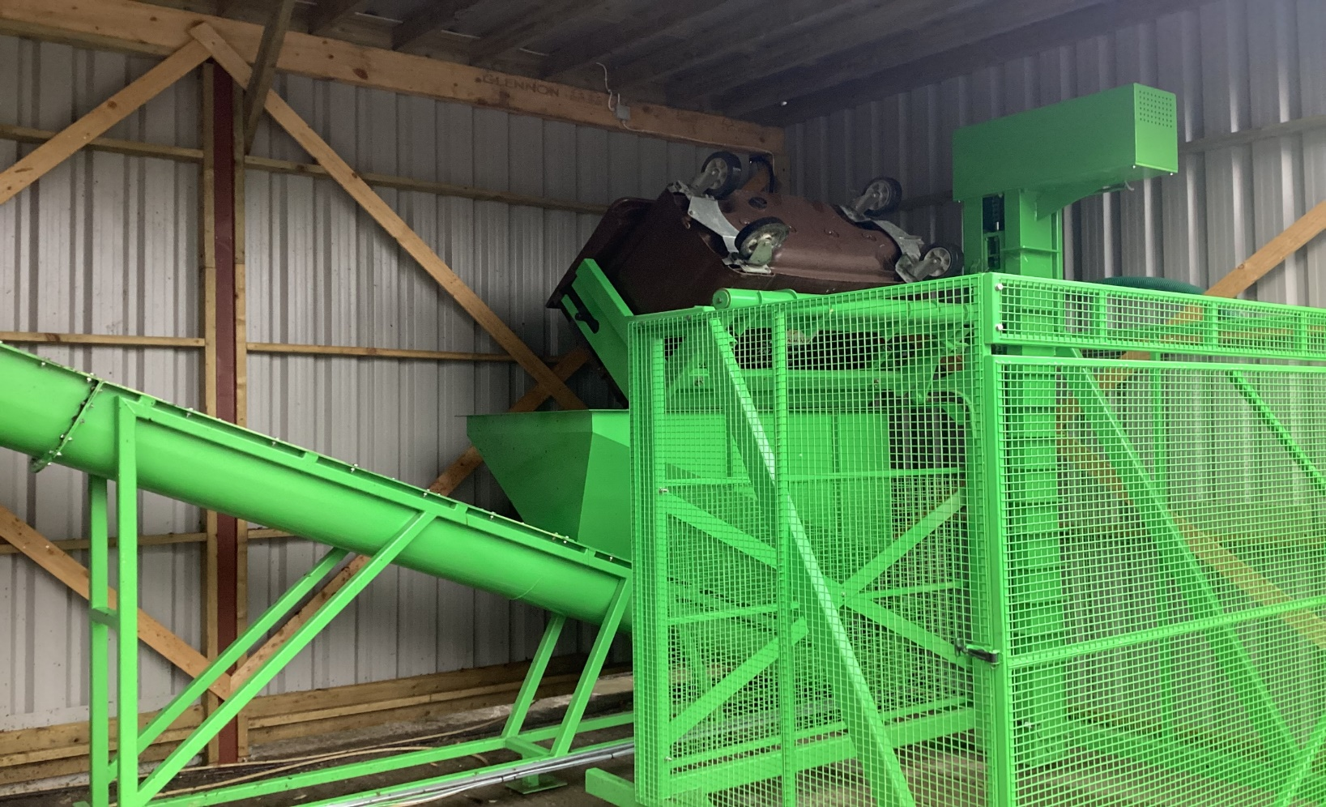
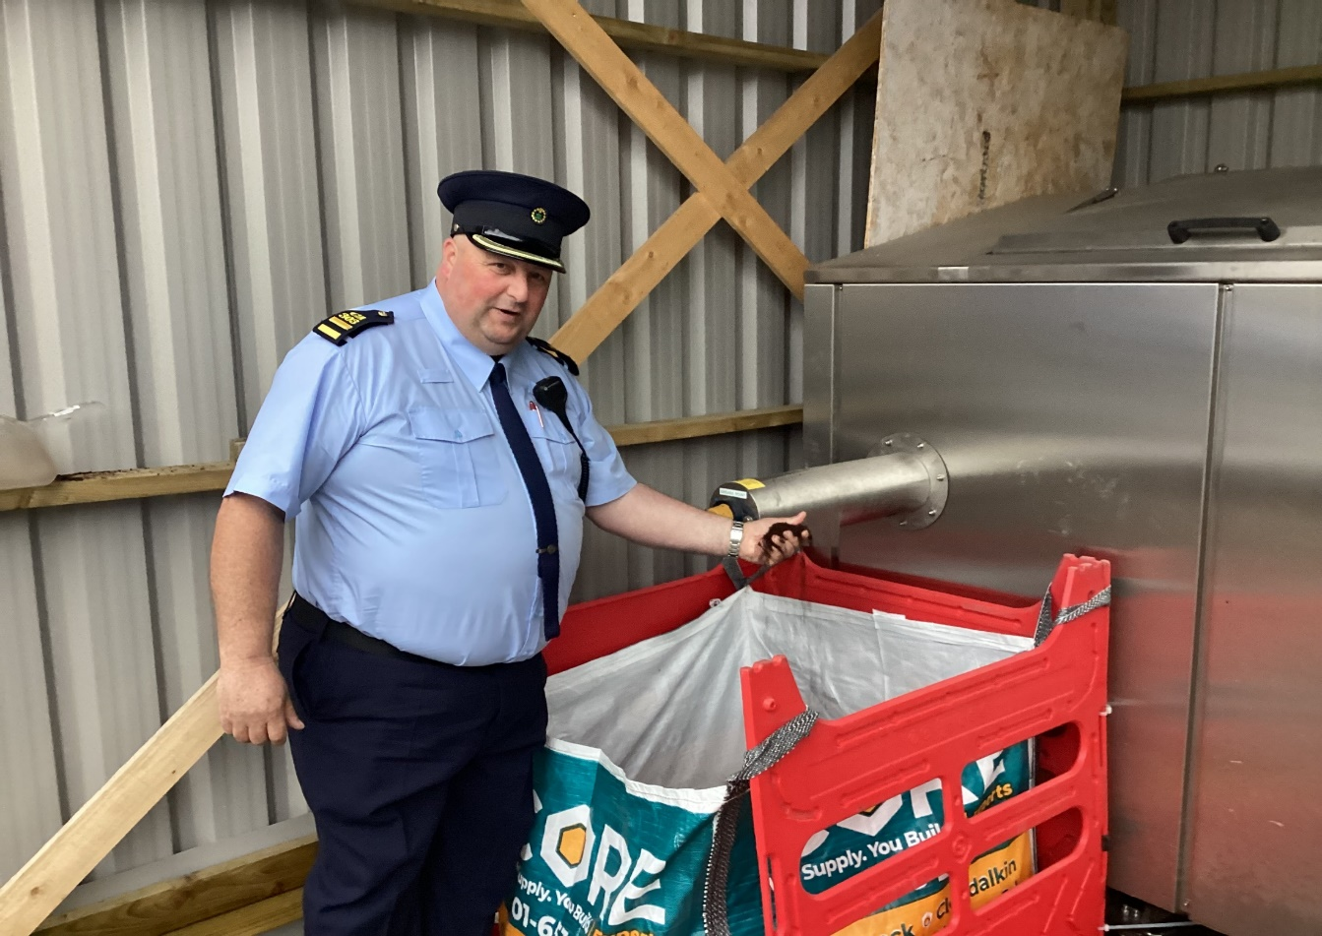
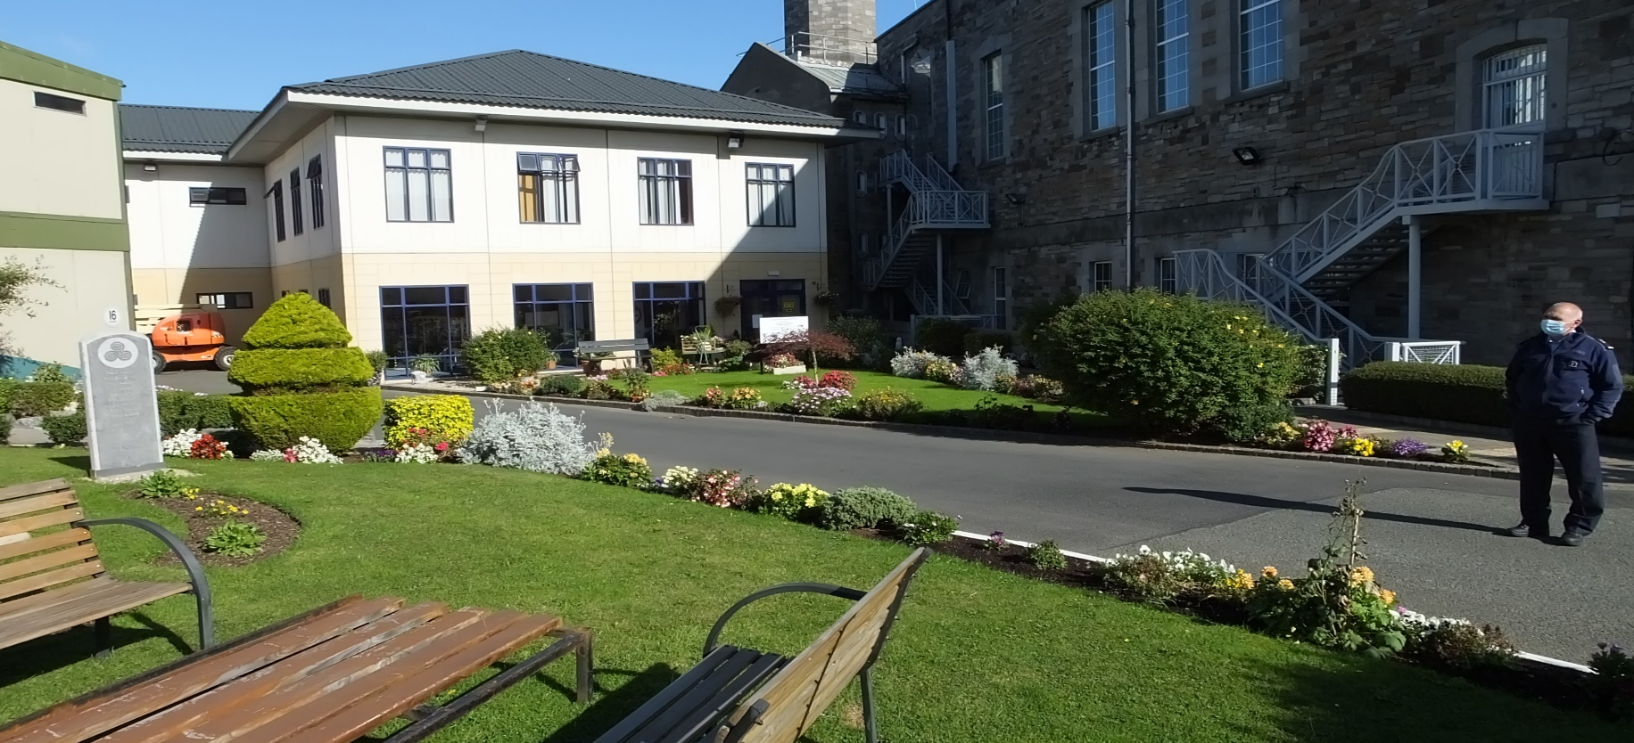

Slide 9
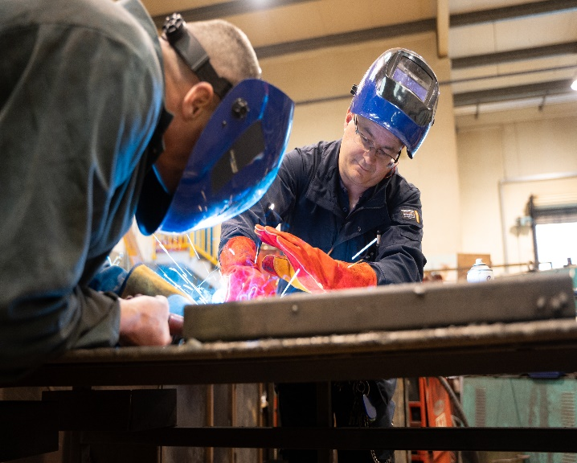
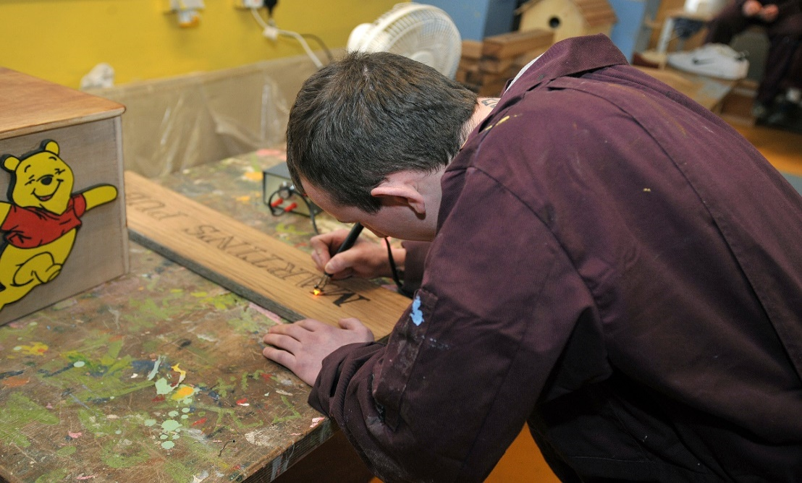
Craft Workshops
Woodwork/Carpentry
Metalwork
Construction/ Building skills
Stone Masonry

Slide 10
NZEB Retrofit
Partnered with The National Construction Training Centre, Mount Lucas, Co Offaly.
IPS WTO’s will deliver and assess the program.
Verification and certification provided by Mount Lucas.

Slide 11
What is NZEB
N – Nearly
Z – Zero
E – Energy
B – Building
‘Nearly Zero – Energy Buildings’ means a building that has a very high energy performance, Annex 1 of the Directive and in which “the nearly zero or very low amount of energy required should be covered to a very significant extent by energy from renewable sources, including energy from renewable sources produced on-site or nearby“.
Since 1st November 2019 all domestic and non-domestic buildings must be built to the NZEB standard.

Slide 12
Achieving NZEB
7 Steps
Continuous insulation
Airtightness/ Vapour Control
Low Thermal Bridging
High Performance Windows
Mechanical Ventilation
High Efficiency Heating
Renewable Energy

Slide 13
Why NZEB Training?
We have the resources in place
We have a well established close relationship with ETB’s Nationwide
Current and relevant to the construction industry
Shortage of workers in the constructions industry – 6092 jobs advertised on www.indeed.com on 19/11/2023.
Government target to retrofit 500.000 homes by 2030
Approximately €17m allocated to develop 6 NZEB Centres of Excellence

Slide 14
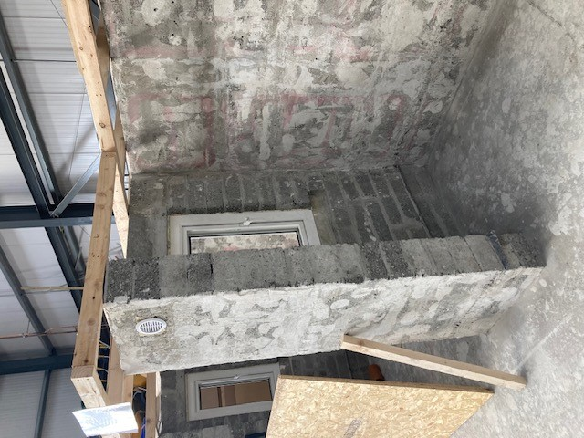
Our Course
Primarily is a practical based course – topics include:
NZEB Fundamentals
Retrofitting Principles & Skills
External wall insulation
NZEB Ventilation
NZEB Airtightness and Vapour Control
Assessments are by ways of a multiple choice theory exam and practical demonstration with a short self-reflective written exercise

Slide 15
Our aspirations
To continually develop and deliver this training program for prisoners
Provide relevant CPD training to our staff
To expand this program to other locations
To grow our relationship with Mount Lucas – explore other opportunities in this and other related construction areas
Forge relationships with potential employers and industry leaders

Slide 16
Thank You
Any questions??
Jimmy Keely Ass. Gov.

