Slide 1

Desistance and Probation Practice
Coffee & Learn Practice Seminar Friday July 7th 2023

Slide 2
Question?
Can probation officers promote desistance during probation supervision?

Slide 3
Overview
* Why is desistance important?
(Grey literature)
* Year 1 – Systematic Narrative Review
(What does existing research say?)
* Year 2 – Probation officer's perspectives of desistance
(What did I find out?)
* Year 3 – Dissemination of research
(What next?)

Slide 4
Why is desistance important?
Recent buzz around desistance in grey literature:
NB – The Desistance Strategy (2015), ceased in 2016 with no formal evaluation. Now the Adult Restorative Justice Strategy (2022).
An Roinn Dlí agus Cirt agus Comhionannas (2020) - Department of Justice and Equality in Ireland
Her Majesty’s Inspectorate of Probation (2021)
Criminal Justice Inspectorate Northern Ireland (2020) “Understanding desistance was inextricably linked to reducing the likelihood of reoffending” .
Northern Ireland Audit Office – Reducing Reoffending in NI (2023) “DoJ is aware of the key factors that impact on reoffending, and has been developing a greater focus on desistance and rehabilitation”

Slide 5
What is commonly known? (deductions from grey literature)
Contested concept
There is no one all-encompassing definition
No one singular theory
Collection of theories, or a ‘movement’

Slide 6
Definitions
“Desistance from crime as a process of “going straight” or “self-reform”
Laub and Sampson, 2001
*“…the long-term abstinence from criminal behaviour among those for whom offending had become a pattern of behaviour”
McNeill et al., 2012
*Adopted definition by the Desistance Strategy (2015)
“At the heart of desistance research is a very simple idea: people can change”
Maruna, 2017
There is value in “bearing witness to desistance”
Anderson, 2016

Slide 7
Desistance - differentiations
Primary desistance – A period free from offending
Secondary desistance – An individual’s perspective of self and the creation of a non-offending identity
Farrall (2004)
Tertiary desistance - individual’s pro-social changes are more successful if there are recognised by others
McNeil (2016)
Act desistance - periods of non-offending
Identity desistance - internalisation of a non-offending identity
Relational desistance - acknowledgement of change through others
Nugent and Schinkel (2016)

Slide 8
Contemporary developments
Then…
Emergence in 1990’s
Individuals ‘drift’
Portrayal as a journey/process
& Now…
Focus shifted to the outcome not the journey
Emancipatory movement
Social rights movement (Maruna, 2017)

Slide 9
Factors impacting upon desistance
- Age/maturation “growing out of it”
- Education “knows better”
- Employment “a steady job”
- Relationships “presence of one pro-social model”
- Substance misuse – insert any “mal-adaptive” practice e.g. gambling .
- Adverse childhood experiences – presence of
- Accommodation - Access to services “post code lottery”

Slide 10
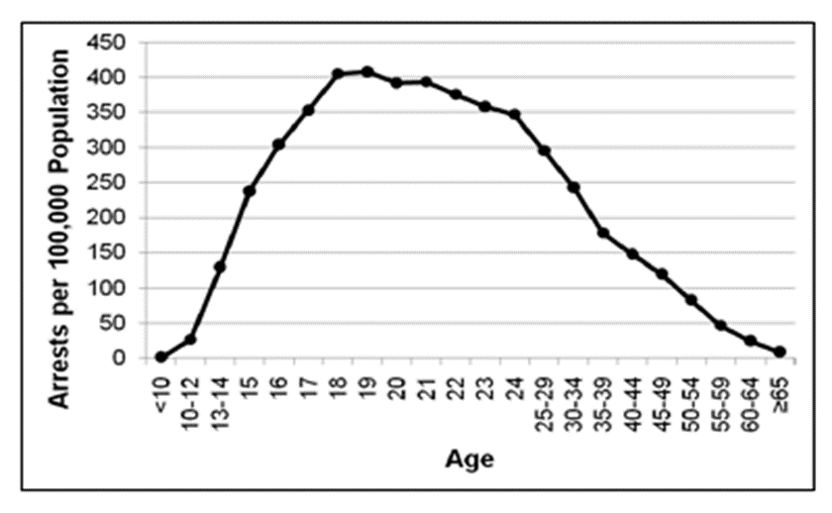
The Age-Crime Curve
“Violence is a young man’s vice: it has been said that the most effective crime fighting tool is a 30th Birthday”
Times Magazine, 1994

Slide 11
“ Our stakeholder engagement found strong consensus that inadequate stable accommodation was the greatest barrier to desistance, given that an address is key to accessing services including healthcare and employment.”
Northern Ireland Audit Office (2023)

Slide 12

Year one:
An Exploration of the Relationship Between
Probation Supervision and Desistance:
A Systematic Narrative Review
08 IPJ Vol 19 An Exploration.pdf (pbni.org.uk)

Slide 13
Methodology
Explore the relationship between desistance and probation supervision
Completed 2021
PsycINFO, Social Care Online, and Criminal Justice Database
Search strategy, boolean algebra
Inclusion/exclusion criteria
314 down to 18 total articles
Quality appraised (QAT’s)
20-year scope (1999 – 2019)

Slide 14
4 Key findings
Supervision offers opportunity to create a new identity, one distanced from an offending history
Supportive relationships are more conducive to fostering desistance
How risk is responded to by services invariably impacts upon perspectives of desistance
The effectiveness of supervision in reducing offending

Slide 15
Identity
Supervision presents an opportunity to create new identity
The Liverpool Desistance Study (Maruna et al. 2004) - acknowledge that a person’s narrative identity changes through out their life
Started as a small-scale study in the US, became fully funded in Merseyside
Simple beginnings, comparing ex-prisoner. Those who desisted vs those who reoffended
Seminal finding – “practitioners should take words seriously” (p.227)
Discourse analysis

Slide 16
Relationships “Good Cop, bad Cop”
There is a limited evidence base to indicate that a supportive relationship yields better results than a non–supportive one – Why is this given our dependence on supervision?
Jersey Study 2011 – After 2 years reconviction rates were significantly lower for those probation officers with a higher skill set.
Leibrich (1993) New Zealand Study of Supervision – the quality of the relationship cited as pivotal to supporting desistance
Power Imbalance – Need to address – “good cop, bad cop”
Key attributes of a ‘good’ probation officer:
1) Empathy,
2) Legitimacy,
3) Practical attributes (time-keeping, problem solving)
4) – “firmness”, ‘bad cop’ is needed

Slide 17
Risk
Strong ties to RnR
Responsivity, specific criminogenic needs are more effectively addressed through intensive supervision, although the increased level of surveillance can adversely lead to more violations of sentence requirements.
Where the frequency of supervision with probationers is determined by an assessment of risk, and where there is a scoring scale, this can result in some criminogenic needs going unmet.
Risk Management – CRC – NPS, lessons learned
Stigma attached to perception of risk

Slide 18
Effectiveness (Does probation supervision work?)
Yes
Wealth of worldwide qualitative data that indicates those under probation supervision re-offend at a lower rate than those who are unsupervised
Same stands for supervision as opposed to custody
Variances in recidivism rates are consequence of a multitude of factors, local, internal…
The evidence base unequivocally portrays supervision’s ability to offer a reduction in offending.

Slide 19
Year two
“Patience, Persistence, and Proportionality”:
Probation Officer’s Perspectives of Desistance in Practice

Slide 20
Research Rationale
Limited research into the perspectives of probation officers (Beck and McGinnis, 2022)
The fundamental directive of probation services is to deliver a reduction in offending (Raynor, 2019)
Desistance from crime is a priority for criminal justice policy, research, and practice (McNeil, 2006)

Slide 21

Methodology
Completed 2022
Qualitative design
Semi-structured interviews
Sample – 15 probation officers
Reflexive thematic Analysis
NVivo12

Slide 22
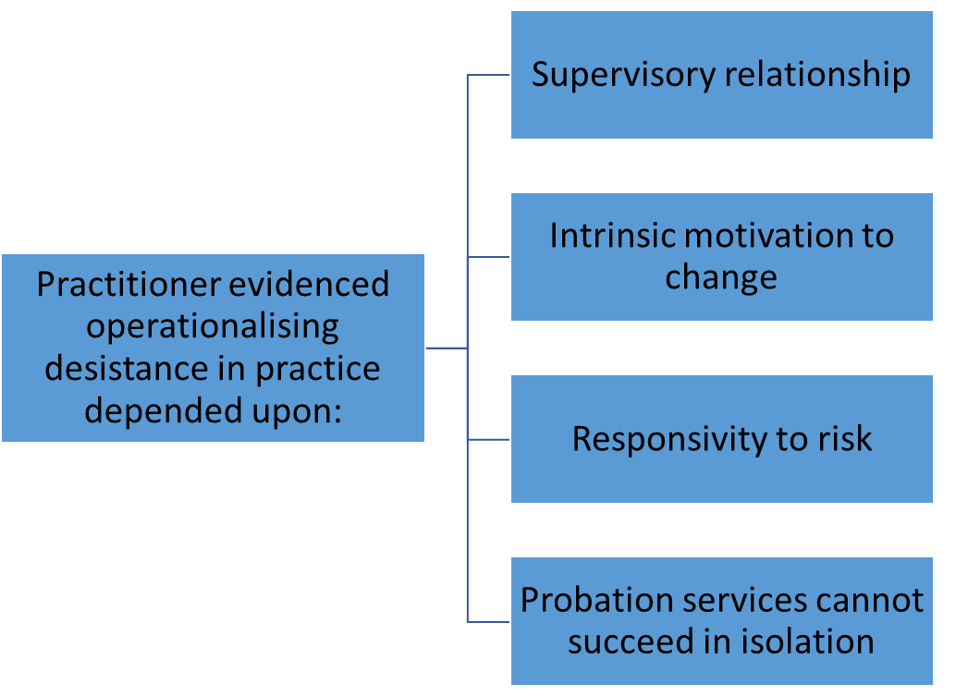
Findings
*Additional finding – how PO’s conceptualise desistance

Slide 23
Supervisory relationships
Relationships central to the promotion of desistance
Premised on social work values
Concept of power – Good Cop/ Bad Cop
The absence of a supportive relationship can adversely impact upon desistance processes
Critical theme – desistance requires patience

Slide 24
Individual’s motivation to change
Motivation to change viewed as prerequisite to desistance
Probation officers considered themselves “agents of change”
Assessment of needs was seminal – inclusive process
Acknowledgement of barriers / hinderances to practice
Critical theme – desistance requires persistence

Slide 25
Responsivity to Risk
What happens when things go wrong?
Practitioner/organisational response to risk invariably impacts upon desistance narratives
Care vs Control debate
Rehabilitation vs Risk Management
“Resources follow risk”
Stigma associated with risk categories – language
Critical theme - proportionality

Slide 26
Probation services cannot succeed in isolation
“Desistance is everyone's business”
Probation officers identified the limitations of their role
Exemplified during COVID-19 – Disconnected from communities
Desistance is not just the priority of the probation officers and services, but the prerogative of all services
Probation supervision is a small cog in a much greater mechanism

Slide 27
Summary of findings
Limitations – study unique to Northern Ireland, not necessarily reflective of wider probation services (especially non-social worker qualified)
Practitioner have an affinity to the desistance informed practice
Desistance focused practices sits well with core-social work values
Desistance requires a greater audience and action
Desistance theory’s development from journey to social movement – A work in progress…

Slide 28
Year Three
Dissemination of Research

Slide 29
Endeavors to disseminate research
Induction
Lectures at Ulsters University
Social work conference & more
Lunch seminars/ coffee mornings

Slide 30
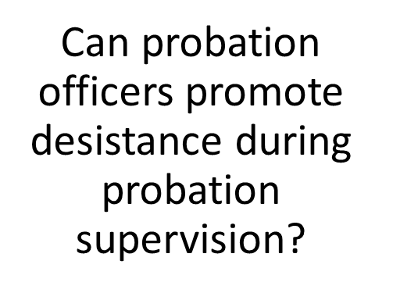
Q:
Probation officers evidenced the promotion of desistance requires:
Patience –relationships are not built overnight
Persistence – changing harmful behaviour requires stamina
Proportionality – What we do when things to go wrong

Slide 31
What’s next for desistance?
Further research into the relationship between probation supervision and desistance & role/impact of the probation officer
More emphasis on the criminal justice system at undergraduate level (widening the training agenda)
Realise the envisioning of the emancipatory movement
Promotion of service-user lead initiatives/co-production
Requirement to view desistance beyond the risk paradigm (can become too rationalized/commodified)

Slide 32
The desistance paradigm
“Put simply, the implication is that offender management services need to think of themselves less as providers of correctional treatment (that belongs to the expert) and more as supporters of desistance processes (that belong to the desister)”
(Fergus McNeill, 2006)

Slide 33
Desistance and Probation Supervision
“At the heart of desistance research is a very simple idea: people can change”
(Maruna, 2017)

Slide 34
References
Anderson, S. (2016) 'The value of 'bearing witness' to desistance', Probation Journal, 64(3), pp. 408-424.
Andrews, D., Bonta, J. and Hoge, R. (1990) 'Classification for effective rehabilitation: Rediscovering psychology', Criminal Justice and Behaviour, 17(1), pp. 19-52.
Corcoran, J. (2016) Motivational Interviewing: A Workbook for Social Workers, Oxford: Oxford University Press
Durnescu, I (2016) 'Experiencing supervision: from 'sparing the first offenders' to 'punishment in the community' and repairing the harm done', in McNeill, F., Durnescu, I. and Butter, R. (ed.) Probation: 12 Essential Questions. London: Palgrave Macmillan, pp. 197-215.
Giordano, P., Cernkovich, A. and Rudolph, J. (2002) Gender, crime and desistance: Toward a theory of cognitive transformation, American Journal of Sociology, 107(4), pp 990-1064.
Hohman, M. (2012) Motivational Interview in Social Work Practice, London: The Guildford Press
Laub, J. and Sampson R. (2001) Understanding desistance from crime. In M. Tony (ed.), Crime and Justice: A Review of Research, Chicago: University of Chicaho Press
Leibrich, J. (1993) Straight to the point: angles on giving up crime, Otago: University of Otago Press.
Maruna, S. (2017) 'Desistance as a social movement', Irish Probation Journal, vol 14, pp. 5-20.
Maruna S, Porter L, Carvalho I. The Liverpool Desistance Study and Probation Practice: Opening the Dialogue. Probation Journal. 2004;51(3):221-232
Matza, D. (1964) Delinquency and Drift. New York: John Wiley.
McAdams, D. (2013) The Redemptive Self. New York: Oxford University Press
McNeil, F. (2016) Desistance and criminal justice in Scotland. In: Groall, H., Mooney, G., and Munro, R. eds. Crime, justice and society in Scotland, London: Routledge, 200-216.
Nugent, B., and Schinkel, M. (2016). ‘The Pains of Desistance’, Criminology and Criminal Justice, 16(5), 568-584.
Trotter, C. (1999). Working with involuntary clients: A guide to practice. London: Sage

Slide 35
?

