Slide 1




Trauma Informed
Art Therapy
Eileen McCourt
Art Therapist (HCPC Reg.).
BAAT NI committee member
(British Association of Art Therapists)
eileenmccourt35@hotmail.com
Dr Caryl Sibbett
Art Therapist (HCPC Reg.).
Vice Chair, BAAT.
Teaching on MSc Art Psychotherapy
(Ret’d programme leader & founder)
caryl@kairosconsultancy.net
Notes:
1.05 LUNCH
1.45 Trauma Informed Art Therapy delivered by Dr Caryl Sibbett & Eileen McCourt
2.20 Long Service Awards
we intend to present on the nature of trauma informed art therapy,
why and how it can contribute to the management of risk and
how it is aligned with other trauma informed approaches (some of which will be communicated by previous presenters).
We will show some images (indicating that this is with consent) and I will speak about my experience of providing an art therapy service in PBNI - Caryl also has extensive experience in providing art therapy in the Criminal Justice system.

Slide 2
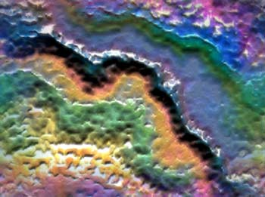

Art Therapy
“a form of psychotherapy” (BAAT, 2023) (Edwards, 2004: 3; Malchiodi, 2003: 38; CSIP/NIMHE, CWP, Royal College of Psychiatrists, 2005: 35)
  “…that uses visual and tactile media as a means of
  self expression and communication.” (BAAT, 2023)
    “Art therapists aim to support people
    of all ages and abilities and
    at all stages of life, to discover an outlet
    for often complex and confusing feelings,
    and foster self awareness and growth.”
    (BAAT, 2023)
    A form of ‘serious play’. (Rieber, Smith & Noah, 1998)
  “in which creating images and objects plays a central role in the psychotherapeutic relationship established between the art therapist and client.” (Edwards, 2004: 2)
UK Professional Organisation
https://baat.org/
Notes:
BAAT (2023) What is art therapy. https://baat.org/art-therapy/
Edwards, David (2004) Art Therapy. London: Sage Publications.
HCPC (2023) Protection of Title. HCPC website. http://www.hcpc-uk.org/complaints/protectionoftitle/
QAA (2004) Subject Benchmark Statements: healthcare programmes, Phase 2, Arts therapy, QAA 059 09/04. Quality Assurance Agency for Higher Education. www.qaa.ac.uk/academicinfrastructure/benchmark/health/ArtsTherapy.pdf
Engel, George L. (1977) The need for a new medical model: a challenge for biomedicine. Science, 196(4286):129-136.
Malchiodi, C.A. (2003) Handbook of Art Therapy. New York, NY: Guilford Press.
CSIP/NIMHE, CWP, Royal College of Psychiatrists (2005) Appendix 3 (a) - Summary of the Traditional Expectations and Modern Aspirations and Distinctive Contributions of staff, service users, carers, and the voluntary sector. In: New ways of working for psychiatrists. Royal College of Psychiatrists and National Institute for Mental Health in England. October. London: Department of Health Publications. Accessed 07 Nov. 2006. www.lincoln.ac.uk/ccawi/publications/Appendix3.pdf via www.lincoln.ac.uk/ccawi/NWWPsych.htm
Rieber, L. P., Smith, L., & Noah, D. (1998) The value of serious play. Educational Technology, 38(6), 29-37. http://lrieber.coe.uga.edu/valueofplay.html

Slide 3
Therapeutic triad
  “The relationship between the therapist and the client is
  of central importance, but art therapy differs from other
  psychological therapies in that it is a three-way process between
  the client, the therapist and the image or artefact.” (BAAT, 2022, p.2) https://www.berkshirehealthcare.nhs.uk/media/109514192/art-therapy-psychological-professions.pdf
Art
Client Art Therapist
(Edwards, 2004: 2, fig.1.1)
Synthesis
Requires management of complex transference and countertransference dynamics across all dimensions of the triad
(Schaverien, 1999: 154)
Notes:
https://www.berkshirehealthcare.nhs.uk/media/109514192/art-therapy-psychological-professions.pdf
Edwards, D. (2004) Art Therapy. London: SAGE.
Schaverien, J. (1999) The Revealing Image: Analytical Art Psychotherapy in Theory and Practice. London: Jessica Kingsley Publishers.

Slide 4

Statutory Regulation
Health & Care Professions Council
  Legislation (HMSO, 1997, 2001). One of the Allied Health Professions (AHP)
2 legally protected titles:
  “Article 39(1) of the Health Professions Order 2001 makes it a criminal offence
  for a person, with intent to deceive (whether clearly or by implication) to:
    say that they are on the HCPC Register;
    use a designated title to which they are not entitled; or
    say falsely that they have qualifications in a profession we regulate.”
    “The words “by implication” mean that an unregistered person may be
    committing an offence even if they do not use the designated title directly
    (for example, if they describe the service they provide as “chiropody” or “physiotherapy”).” (HCPC, 2023)
    or, for example, as ‘art therapy’ or ‘art psychotherapy’
https://www.hcpc-uk.org/concerns/what-we-investigate/misuse-of-title/ https://www.hcpc-uk.org/about-us/who-we-regulate/the-professions/
‘Art Therapist’
‘Art Psychotherapist’
Notes:
HCPC (2023) Protection of Title. HCPC website. http://www.hcpc-uk.org/complaints/protectionoftitle/
1998 onwards art therapists came under the CPSM, under the Professions Supplementary to Medicine Act 1960 (the Act).
Edwards, David (2004) Art Therapy. London: Sage Publications.
BAAT (2023) What is art therapy. BAAT website.
QAA (2004) Subject Benchmark Statements: healthcare programmes, Phase 2, Arts therapy, QAA 059 09/04. Quality Assurance Agency for Higher Education. Last accessed 14 July 2007. www.qaa.ac.uk/academicinfrastructure/benchmark/health/ArtsTherapy.pdf

Slide 5

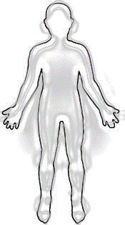
Trauma informed
Art Therapy
A Trauma Informed Approach shifts the focus:
from - What’s wrong with you?
to - What happened to you?
What do you need? What can help?
Trauma Informed Art Therapy is:
  Guided by research: ACEs (Felitti et al, 1998),
  PCEs (Positive experiences), neuroscience etc.
  Guided by theories: therapy, systemic etc.
  Person-centred. Holistic. Multi-sensory.
  Strengths-based. Risk & protective factors.
  Underpinned by TIA / TIP principles …
  (Harris & Fallot, 2001; Fallot and Harris, 2009; SAMHSA, 2014; Sweeney et al, 2016)
Notes:
Felitti, V. J., Anda, R. F., Nordenberg, D., Williamson, D. F., Spitz, A. M., Edwards, V., Loss, M.P. & Marks, J. S. (1998) Relationship of childhood abuse and household dysfunction to many of the leading causes of death in adults: The Adverse Childhood Experiences (ACE) Study. American Journal of Preventive Medicine, 14(4), 245-258.
Figley, C. R. (Ed.). (1995) Compassion fatigue: Coping with secondary traumatic stress disorder in those who treat the traumatized. Brunner/Mazel.
Fallot, R., and Harris, M. (2006) Trauma-informed services: A self-assessment and planning protocol. Washington: Community Connections.
Harris, M. and Fallot, R.D. (2001) Using Trauma Theory to Design Service Systems. San Francisco: Jossey-Bass.
SAMHSA (2014) SAMHSA’s Concept of Trauma and Guidance for a Trauma-Informed Approach. HHS Publication No. (SMA) 14-4884. Rockville, MD: Substance Abuse and Mental Health Services Administration. https://store.samhsa.gov/sites/default/files/d7/priv/sma14-4884.pdf
Sweeney, A., Clement, S., Filson, B. & Kennedy, A. (2016) Trauma-informed mental healthcare in the UK: what is it and how can we further its development? Mental Health Review Journal, Vol. 21 No. 3, pp. 174-192. https://www.emerald.com/insight/content/doi/10.1108/MHRJ-01-2015-0006/full/html
https://www.gov.uk/government/publications/working-definition-of-trauma-informed-practice/working-definition-of-trauma-informed-practice

Slide 6










TIA principles
(Harris & Fallot, 2001; Fallot and Harris, 2009; SAMHSA, 2014; Sweeney et al, 2016)
  Trauma
  awareness recognise prevalence, types, levels &
  impacts of trauma
  Resist
  re-traumatisiation managing power & avoiding retraumatising practices
  Safety physical psychological, moral & cultural safety
  Empowerment, choice, control strengths-based approaches, building strengths & skills, individualised approach, promoting voice & autonomy
  Collaboration, mutuality power aware & sharing, shared decision-making, respect, connection, hope
  Trustworthiness, transparency fidelity, building trust, openness
Co-production
  Cultural awareness / competence recognising historical & community-specific trauma, impact of intersectionalities, cultural healing potential, gender responsive, prizing diversity
  Pathways to trauma-specific care signposting, referral, co-ordination
  Peer support survivor self / help,
  partnerships
  (These TIA Principles underpin NI Master’s level Art Psychotherapy training as designed by Dr Sibbett 2015)
Notes:
Images mostly from https://www.traumainformedcare.chcs.org/what-is-trauma-informed-care/
Realisation – Recognise – Respond – Resist re-traumatisation (SAMHSA, 2014)
Felitti, V. J., Anda, R. F., Nordenberg, D., Williamson, D. F., Spitz, A. M., Edwards, V., Loss, M.P. & Marks, J. S. (1998) Relationship of childhood abuse and household dysfunction to many of the leading causes of death in adults: The Adverse Childhood Experiences (ACE) Study. American Journal of Preventive Medicine, 14(4), 245-258.
Figley, C. R. (Ed.). (1995) Compassion fatigue: Coping with secondary traumatic stress disorder in those who treat the traumatized. Brunner/Mazel.
Fallot, R., and Harris, M. (2006) Trauma-informed services: A self-assessment and planning protocol. Washington: Community Connections.
Harris, M. and Fallot, R.D. (2001) Using Trauma Theory to Design Service Systems. San Francisco: Jossey-Bass.
SAMHSA (2014) SAMHSA’s Concept of Trauma and Guidance for a Trauma-Informed Approach. HHS Publication No. (SMA) 14-4884. Rockville, MD: Substance Abuse and Mental Health Services Administration. https://store.samhsa.gov/sites/default/files/d7/priv/sma14-4884.pdf https://ncsacw.acf.hhs.gov/userfiles/files/SAMHSA_Trauma.pdf
Sweeney, A., Clement, S., Filson, B. & Kennedy, A. (2016) Trauma-informed mental healthcare in the UK: what is it and how can we further its development? Mental Health Review Journal, Vol. 21 No. 3, pp. 174-192. https://www.emerald.com/insight/content/doi/10.1108/MHRJ-01-2015-0006/full/html

Slide 7
Art therapy in PBNI (from 1987-2011 – 24 years)
  Initial experiential staff workshops to introduce its theory and practice for maximising relevant referrals
  Team of supervised volunteers provided the service both in the community and prisons over many years
  Structured referral system and review processes ensured integration in clients’ supervision plans

Slide 8
Staff feedback - Art therapy enhanced the supervision process through:
  Provision of a ‘calm and non-threatening environment’
  allowing behaviours and moods to emerge which may not
  have been evident elsewhere, leading to a fuller risk assessment
  Contributing to the monitoring and managing of personality traits through structured creativity
  Extending possibilities of emotional expression beyond verbal means
Client feedback - Art therapy helped:
  The development of concentration, focus and patience
  Feelings of accomplishment and achievement
  Reduction of stress and opportunities for relaxation

Slide 9
CLIENT FEEDBACK:
‘It’s a sense of achievement. You know, doing something you didn’t
think you could do. It makes you feel good about yourself, seeing
(the picture) going through all the different stages’.
‘It’s therapeutic. You could get into it. Nothing’s unusual in art –
you can do whatever you want and everybody’s different’.
‘I know what this art is about – it’s about drawing your own conclusions’.
“I get it, this is a different way to draw a gun!”
“…red paint instead of blood.”
‘The painting doesn’t get rid of the feeling – but it’s shared with somebody’.
‘The benefits of art therapy don’t finish just because the picture is finished –
it carries on, surely? When we walked out of the room,
that wasn’t the end of it, otherwise what was the point in keeping the pictures?’

Slide 10
‘It is the task of the therapeutic relationship, by achieving a therapeutic alliance, to understand this propensity to destructive acting-out, and to be able to get it into words and to discuss it rather than it needing to be endlessly actually repeated.
It is also the case that many [clients] find talking rather than acting, either different or quite beyond their capacities.
There may be relative degrees of incapacity to symbolise and a “concretisation” of thought. In these cases, the arts therapies - whether art, music or drama - may be particularly helpful in allowing a therapeutic alliance to grow “without words’’.’
(Cordess, 2002, pp.82-83)
Cordess, Christopher (2002) Building & Nurturing a Therapeutic Alliance with Offenders. Chapter 5 in McMurran, Mary (Ed.) Motivating Offenders to Change. A Guide to Enhancing Engagement in Therapy. John Wiley & Sons Ltd.
Notes:
Cordess, Christopher (2007) Building & Nurturing a Therapeutic Alliance with Offenders. Chapter 5 in McMurran, Mary (Ed.) Motivating Offenders to Change. A Guide to Enhancing Engagement in Therapy. Chichester: John Wiley & Sons Ltd.

Slide 11
1
Artwork withheld for confidentiality reasons
61 x 51cm acrylic on canvas board
61 x 51cm acrylic on canvas board
Notes:
CONFIDENTIAL – not for copying or circulation

Slide 12
2
Artwork withheld for confidentiality reasons
61 x 51cm acrylic on canvas board
61 x 51cm acrylic on canvas board
Notes:
CONFIDENTIAL – not for copying or circulation

Slide 13
3
Artwork withheld for confidentiality reasons
61 x 51cm acrylic on canvas board
Notes:
CONFIDENTIAL – not for copying or circulation

Slide 14
4
Artwork withheld for confidentiality reasons
61 x 51cm acrylic on canvas board
61 x 51cm acrylic on canvas board
Notes:
CONFIDENTIAL – not for copying or circulation

Slide 15
‘A significant effect of art therapy was a very informal, relaxed
and comfortable atmosphere to talk about problems I was having with my picture and without noticing making a direct comparison with some of the problems I have with my attitudes. And doing this in a non-analysing way made it easy and interesting.
So this made the taking-in or understanding of this very easy.
Looking at the problem on the canvas was, although a bit
frustrating at times, it wasn’t serious. So that made it easier to come up with solutions and try different ways of overcoming them. And then the realisation I could try this with my New Thinking Plan came through talking about these ‘ways’ with the art therapist.’ …

Slide 16
‘If I can come up with solutions – and sometimes fail – for problems I haven’t encountered before (my first canvas) and get a
satisfactory result, then that’s a positive and satisfactory experience I have achieved and might be able to translate this into my New Thinking Plan.
Realising all of a sudden through talking with the art therapist,
the connection between Art Therapy and CSCP e.g. talking through problems, hurdles in relation to my picture, a direct or indirect comparison to the problems I face with my behaviour and attitude.
It was frustrating at times but there were only positive challenges. It’s like risking consequences – taking chances where there’s no consequences. Experiencing this could spill over into real life.’

Slide 17

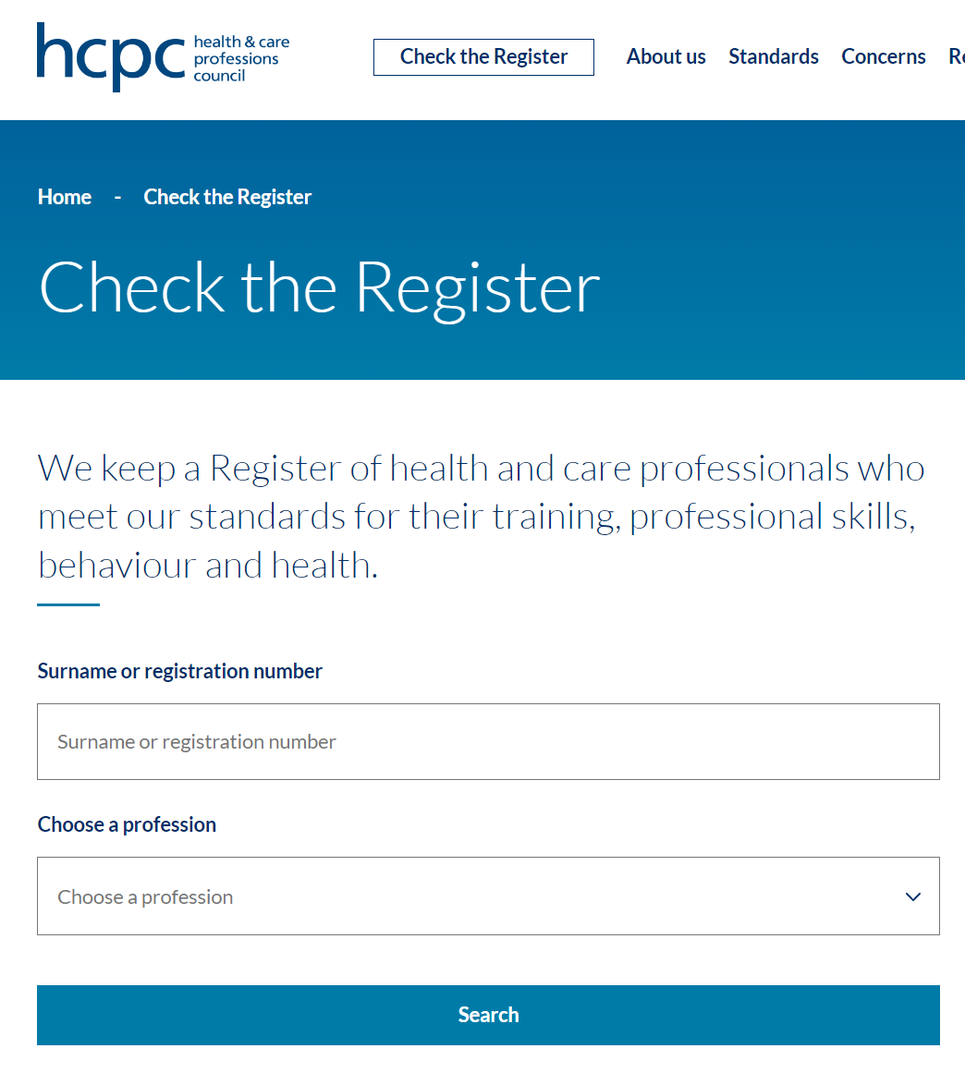
Statutory Regulator
  CHECK THE
  HCPC REGISTER
  https://www.hcpc-uk.org/check-the-register/
  ☒ ☑
Notes:
https://www.professionalstandards.org.uk/what-we-do/our-work-with-regulators
https://www.professionalstandards.org.uk/what-we-do/accredited-registers

Slide 18
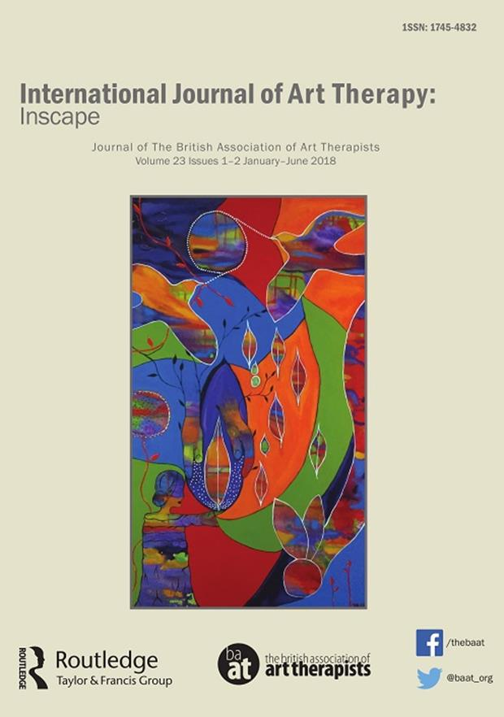

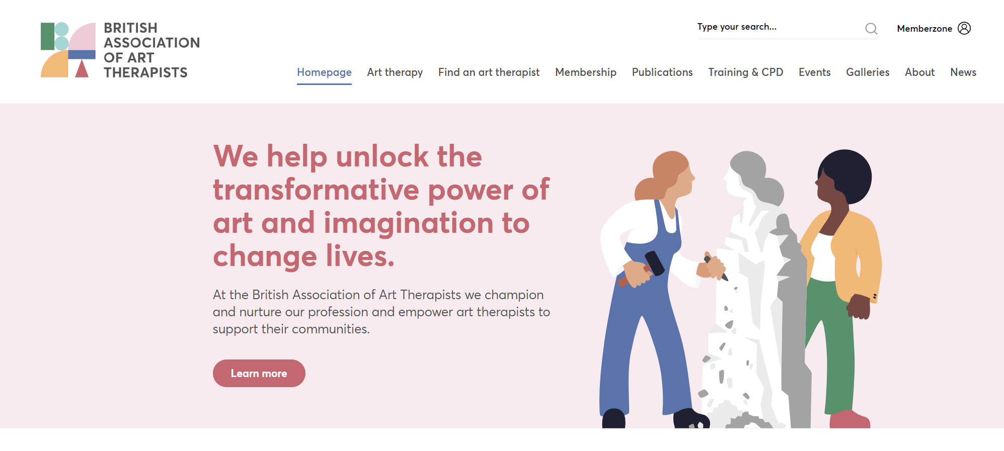

Professional Body:
British Association of Art Therapists
https://baat.org/
BAAT
  UK professional organisation
  / learned society
Notes:
https://baat.org/

Slide 19
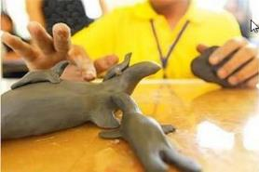
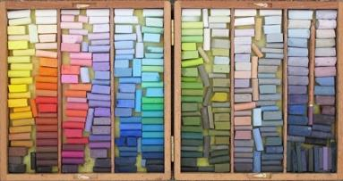
HCPC & BAAT
Proficiency & risk management
“Safe and effective”: Art Therapy / Art Psychotherapy e.g.
  HCPC (2023) Standards of Proficiency – Arts therapists.
  HCPC (2013) Standards of Proficiency – Arts therapists.
  HCPC (2016) Standards of Conduct, Performance and Ethics.
  BAAT (2019) Code of Ethics and Principles of
  Professional Practice for Art Therapists.
  Art Therapists are trained in
  risk management e.g.:
  Springham, N. (2008) Through the eyes of the law: What is it about art that can harm people? International Journal of Art Therapy, Formerly Inscape, Volume 13, Issue 2. https://www.tandfonline.com/doi/full/10.1080/17454830802489141
Notes:
BAAT (2019) Code of Ethics and Principles of Professional Practice for Art Therapists. London: British Association of Art Therapists.
HCPC (2023) Standards of Proficiency – Arts Therapists. London: HCPC. From September 2023.
HCPC (2013) Standards of Proficiency – Arts Therapists. London: HCPC.
HCPC (2016) Standards of conduct, performance and ethics. London: HCPC.
Springham, N. (2008) Through the eyes of the law: What is it about art that can harm people? International Journal of Art Therapy, Formerly Inscape, Volume 13, Issue 2. https://www.tandfonline.com/doi/full/10.1080/17454830802489141

Slide 20









https://www.kairosconsultancy.net/
 | BAAT | BAAT NI | HCPC
 | hello@baat.org | region20@baatcrs.org | https://www.hcpc-uk.org/contact-us/
 | https://baat.org/ |  | https://www.hcpc-uk.org/
 | https://twitter.com/baat_org | https://twitter.com/Baat_NIreland | https://twitter.com/The_HCPC
 | https://www.facebook.com/thebaat/ | https://www.facebook.com/BAATNI | https://www.facebook.com/hcpcuk
 | https://www.instagram.com/baat_org/ | https://www.instagram.com/baat_ni/

