Slide 1
Domestic Abuse – Policing the Pandemic
D/Supt Lindsay FISHER

Slide 2
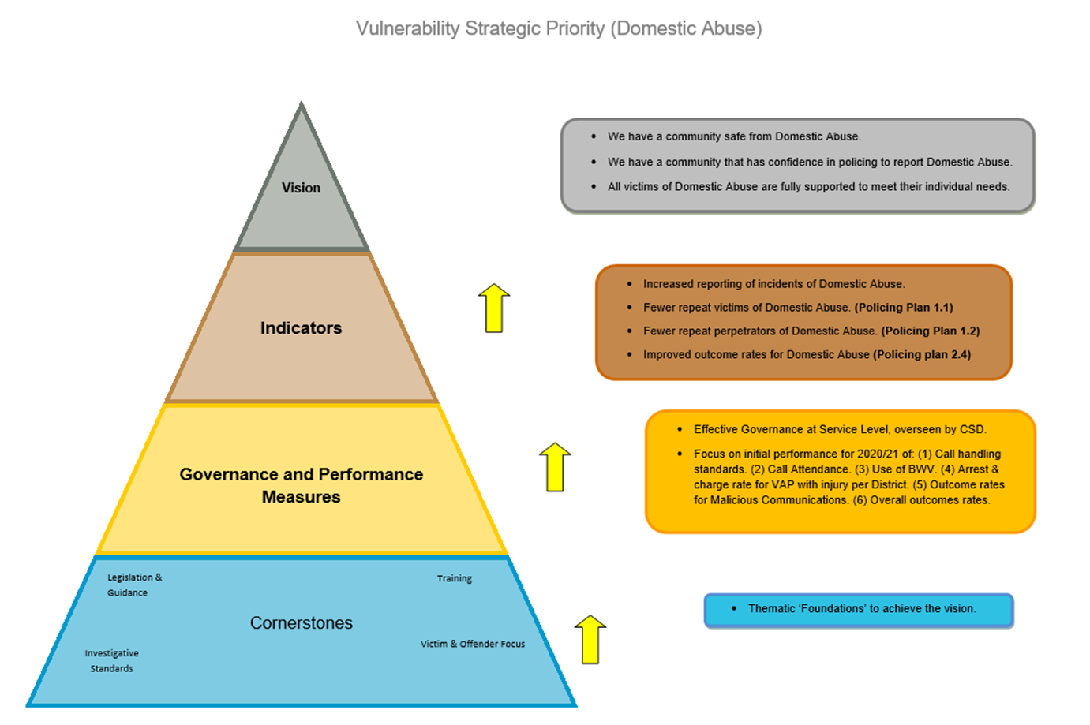
Domestic abuse

Slide 3
Domestic abuse – stats landscape
In the last financial year there were 33186 domestic abuse incidents in NI and increase of 1990 on the previous 12 months
The number of domestic abuse crimes also rose to 21723 an increase of 2698 on the previous 12 months and again highlighted as the highest figures since the data series started in 2004/2005
An average of 18 domestic abuse incidents and 11 domestic abuse crimes per 1000 population
Increases in all major crime types except criminal damage
All 11 policing districts experienced higher levels of domestic abuse

Slide 4
Domestic abuse definition
“Threatening, controlling, coercive behaviour, violence or abuse (psychological, virtual, physical, verbal, sexual, financial or emotional) inflicted on anyone irrespective of age, ethnicity, religion, gender, gender identity, sexual orientation or any form of disability, by a current or former intimate partner or family member”
This definition has been adopted by Police from NI Government Strategy “Stopping Domestic and Sexual Violence and Abuse in Northern Ireland”

Slide 5
Crime V Incident
There are a number of key differences between the two aspects when police are called for attendance at a domestic “call for service”
This may be to prevent a crime – breach of the peace for example if a person knows that a partner is coming to retrieve property or where a civil order has not been adhered to
This could have been reported as a crime but on attendance by Police it did not meet the criminal threshold
Has the landscape changed now with the new domestic abuse legislation

Slide 6
What did we do during the pandemic to support victims of domestic abuse
Repeat victim call back scheme – all victims
Repeat Victims call back – Public Protection Branch
Covid Partners meeting
Policed an increasing overall demand
Maintained high criminal justice outcomes for victims of domestic abuse
Planned for future projects including domestic abuse pilot court, new legislation, new protective orders
Maintained the governance and accountability structures required for domestic abuse investigations
Joint working with Statutory partners to introduce Domestic Homicide Review process
Launch of new Advocacy Services for victims of domestic and sexual abuse victims

Slide 7
What changes in trends did we see
Not only did the overall crime increase but stats would also indicate that during lockdown periods we would have seen higher severity of crimes committed
An increased reporting of domestic sexual abuse offences at various junctures during the pandemic
Until the pandemic years Christmas was always recorded as the period of highest reporting – however domestic abuse incidents peaked in July 2020 (2908) and July 2021 (2981). February remains consistently the period where lowest reporting was experienced

Slide 8
Domestic Abuse & Civil Proceedings Act (NI) 2021
The key elements of this legislation are as follows:
Creates new Domestic Abuse offence,
Criminalises abusive behaviour,
Creates aggravators that can be attached to the domestic abuse offence and other statutory legislation,
Supports victims by ensuring they are considered for special measures
This legislation does not have retrospective effect

Slide 9
Key aspects of new offence
A person commits an offence if all the following FOUR conditions are met:
Offender engages in a course of behaviour¹ which is abusive of another person.
The offender and victim are personally connected to each other at the time, and
A reasonable person would consider the course of behaviour would be likely to cause the victim physical or psychological harm²; this includes fear, alarm and distress.
They intend³ the course of behaviour to cause the victim to suffer physical or psychological harm, or is reckless as to whether the course of behaviour causes the victim to suffer physical or psychological harm

Slide 10
Key aspects of the new offence
Are they personally connected?
A course of behaviour involves behaviour that has taken place on at least two occasions.
The behaviour need not be the same on the 2 or more occasions provided it meets the definition of abusive behaviour.
The Act does not provide that any two incidents automatically amounts to a “course of behaviour”. Two entirely isolated or standalone instances of behaviour would not amount to a course of behaviour.
The courts are familiar with the concept of a “course of conduct”, and can distinguish between this and separate instances that are unconnected by time or circumstance. A similar formulation is used in, for example, the offence of harassment
Behaviour abusive?
Behaviour that is violent (this includes physical and sexual violence).
Behaviour that is threatening,
Behaviour that is directed at the victim, a child (a person under 18 years of age) of the victim or any other person that has as its purpose one or more of the relevant effects on the victim;

Slide 11
Giving confidence to victims – what are Police doing in this area
Continued work with voluntary and statutory partners to ensure that training and awareness is trauma informed and victim focused
New training rolled out to almost 6000 officers / staff on coercive control to recognise the signs of the new offence
New training packages prepared for upcoming legislative changes – Stalking behaviours and The Justice (Sexual Offences and Human Trafficking Bill) which will see changes to Non Fatal Strangulation offence and new offences of up skirting / down blousing
Thinking evidence led – use of body worn video to seek to secure criminal justice outcomes. We see over 90% compliance with usage at domestic abuse emergency calls
Dip sample quality of risk assessments and referrals
Dip sample investigative standards with domestic abuse specialists in PPS
Each domestic abuse incident is reviewed by at least one level of senior management each day
Domestic abuse monthly performance meetings across the end to end service
Improve visual and digital aids for first responders – to include process maps, case studies, animations which highlight new offences and practices to be followed
Full support to the DHR process to identify learning through the tragic fatal domestic abuse

